Slide 1

8/8/2017
Implementing a High-Performance Computing Center
Quinn Stratton
Mentor: Dr. Ray Klump

Slide 2
Acknowledgements
Dr. Livingston
Dr. Schlachter
Dr. Klump
Dr. Powers
S.U.R.E.
http://www.criticalcommons.org/Members/ccManager/clips/a-recalcitrant-supercomputer-defies-its-operator-in-willy-wonka-and-the-chocolate-factory/thumbnailImage

Slide 3
Motivation
Computation is playing a greater and greater role in science
Bring this power to Lewis
Understand high-performance computing through the use of small-scale models

Slide 4
Methods
Cluster computing involves writing programs that run on multiple computers (nodes) in parallel
MPI (Message Passing Interface): Used to implement message-passing parallel programming model
Primarily specified for C and Fortran
CUDA: Programming platform for developing on GPUs
Provides libraries for C, C++, and Fortran

Slide 5
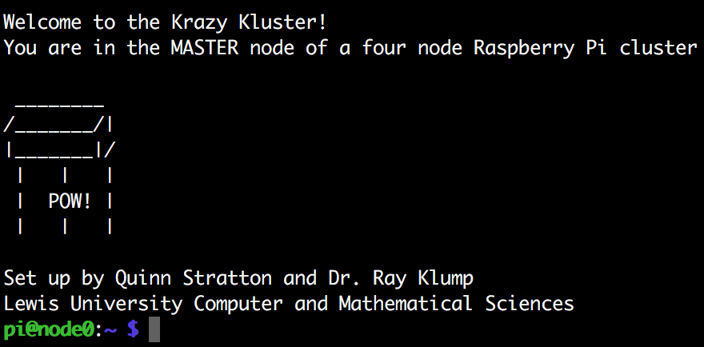
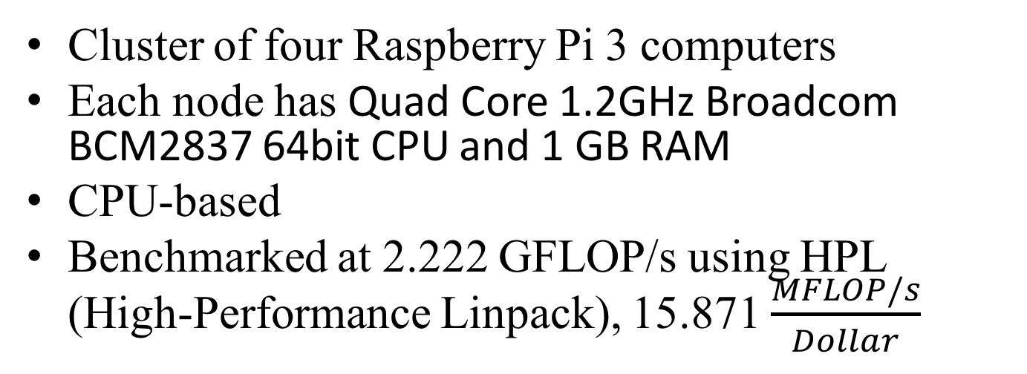
Raspberry Pi 3 Cluster
Cluster of four Raspberry Pi 3 computers
Each node has Quad Core 1.2GHz Broadcom BCM2837 64bit CPU and 1 GB RAM
CPU-based
Benchmarked at 2.222 GFLOP/s using HPL (High-Performance Linpack), 15.871 $\frac{MFLOP/s}{Dollar}$
https://www.raspberrypi.org/app/uploads/2015/08/raspberry-pi-logo.png

Slide 6
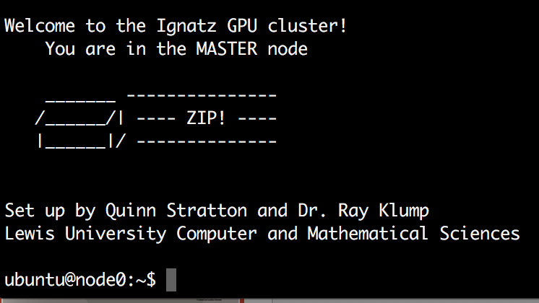
Jetson TK1 Cluster
Cluster of four Jetson TK1 computers
Each node has NVIDIA 4-Plus-1™ Quad-Core ARM® Cortex™-A15 CPU AND NVIDIA Kepler GPU with 192 CUDA Cores
GPUs: More computing throughput, more FLOP/s per Watt

Slide 7
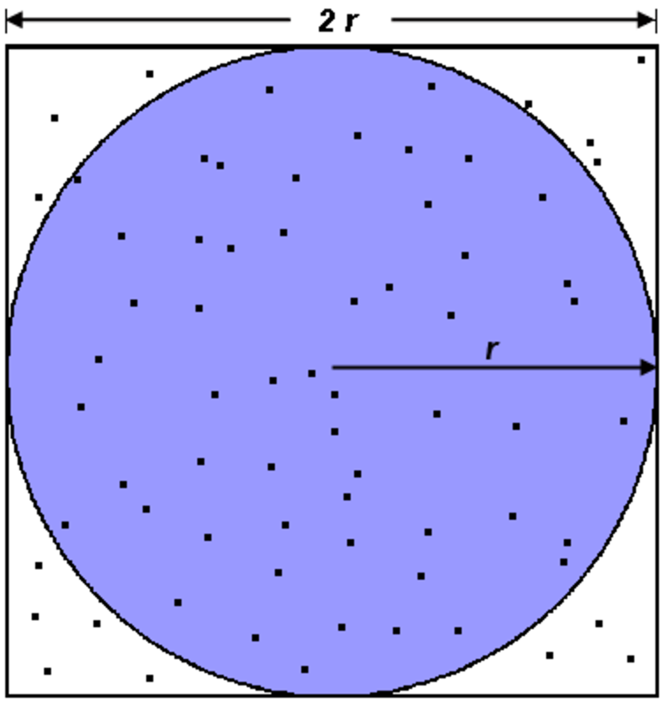
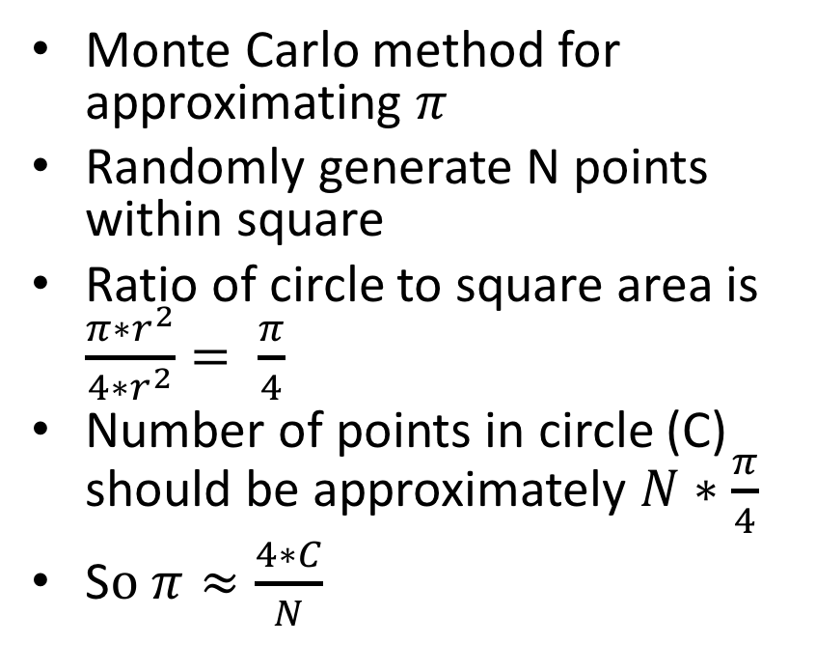
Case Study: pi_approx
Monte Carlo method for approximating $π$
Randomly generate N points within square
Ratio of circle to square area is $\frac{π∗r^{2}}{4{∗r}^{2}}= \frac{π}{4}$
Number of points in circle (C) should be approximately $N∗\frac{π}{4}$
S$o π≈\frac{4∗C}{N}$

Slide 8
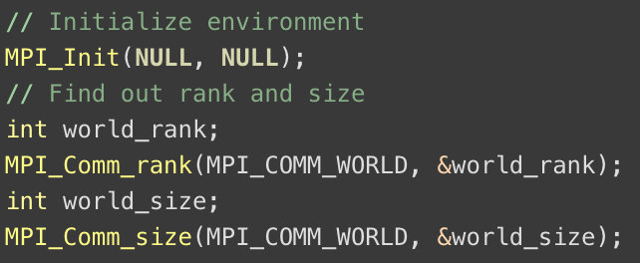
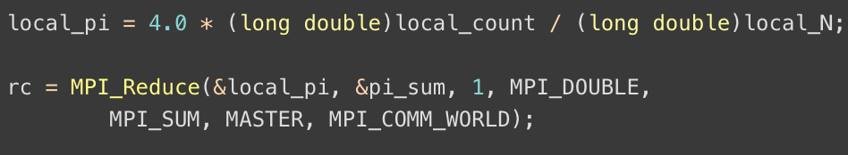
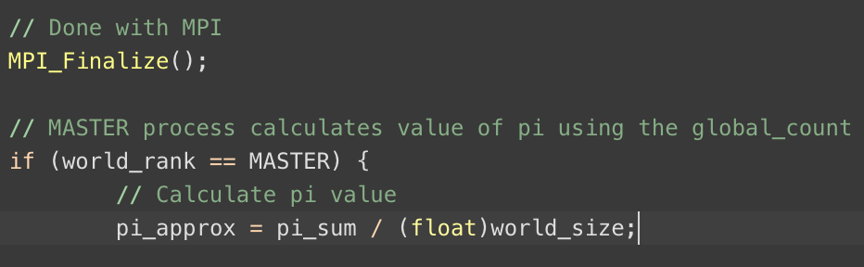
MPI only

Slide 9
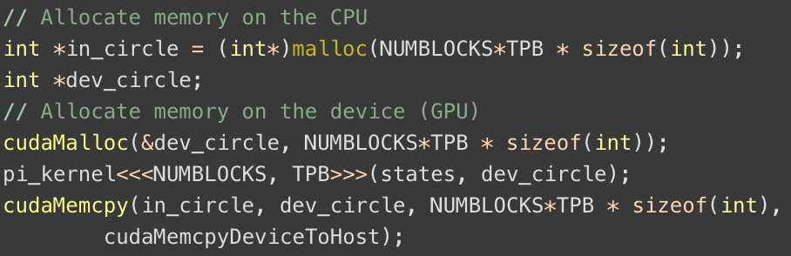
MPI with CUDA
MPI handles splitting task up among nodes
CUDA makes use of GPU

Slide 10
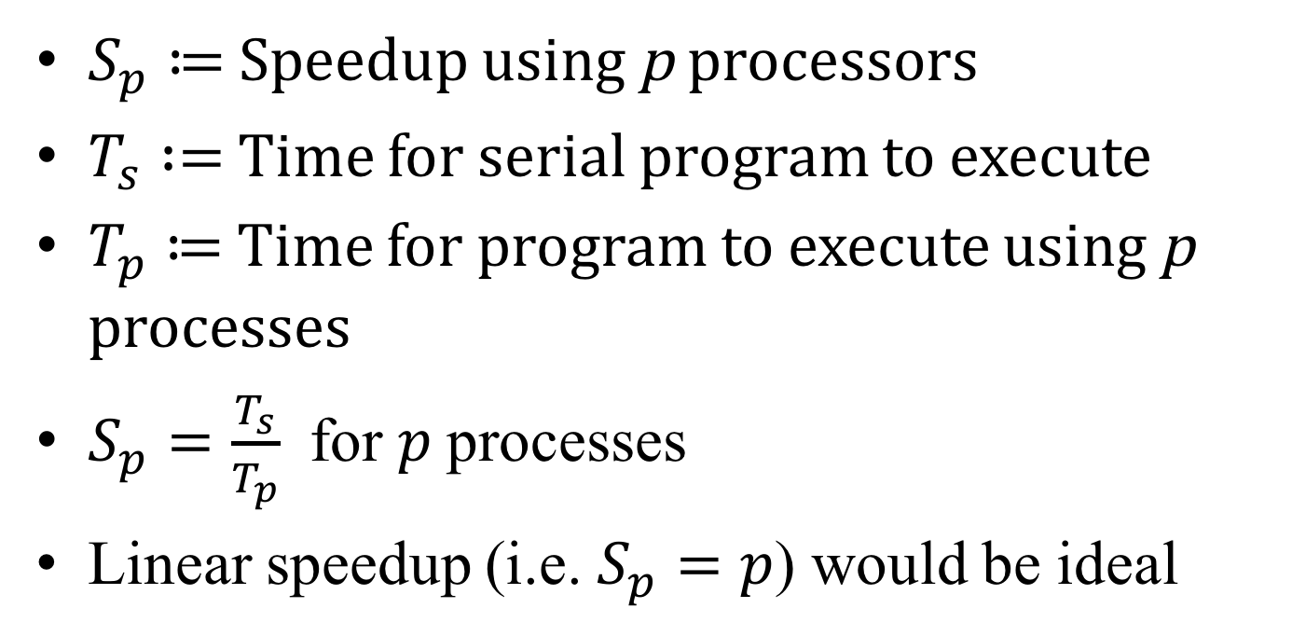
Speedup
$S_{p}≔$Speedup using p processors
$T_{s} :=$ Time for serial program to execute
$T_{p}≔$ Time for program to execute using p processes
$S_{p}=\frac{T_{s}}{T_{p}}$ for $p$ processes
Linear speedup (i.e. $S_{p}=p$) would be ideal

Slide 11
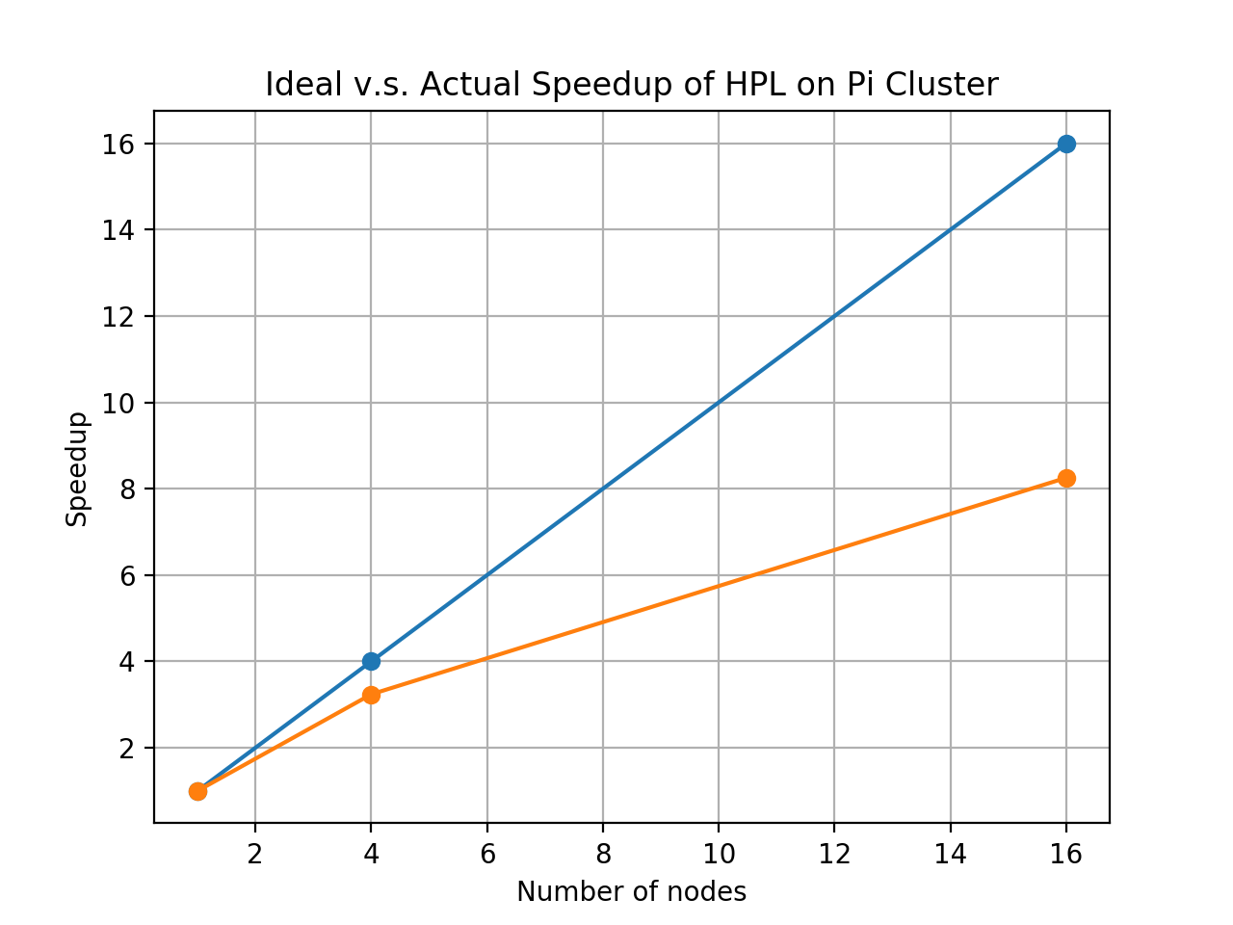
Speedup of HPL on Raspberry Pi cluster

Slide 12
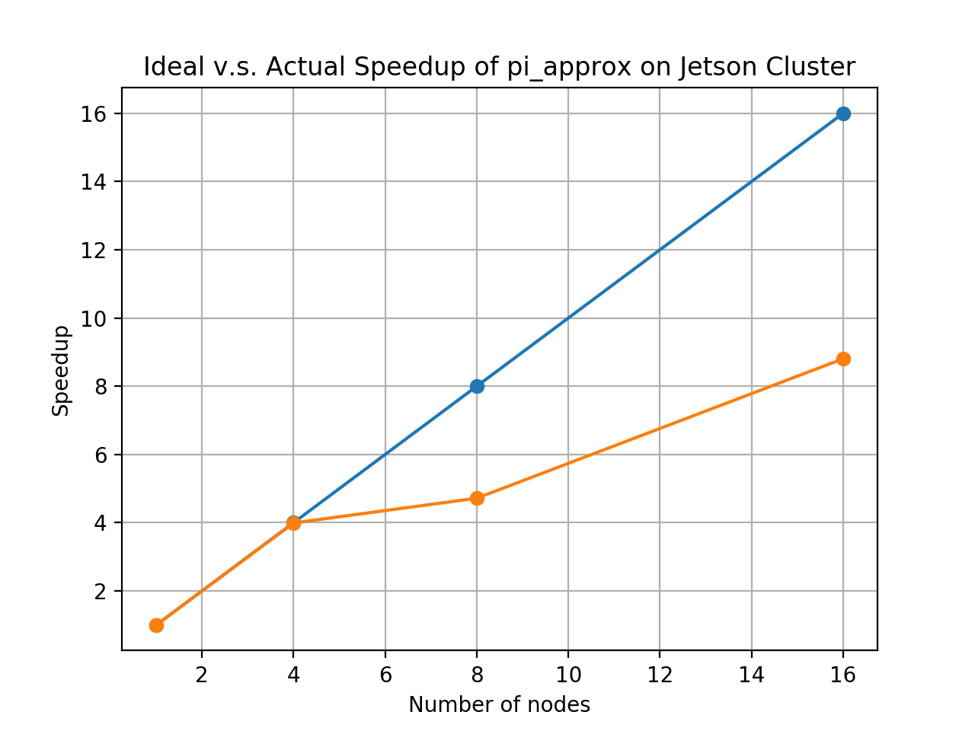
Speedup of pi_approx on Raspberry Pi Cluster

Slide 13
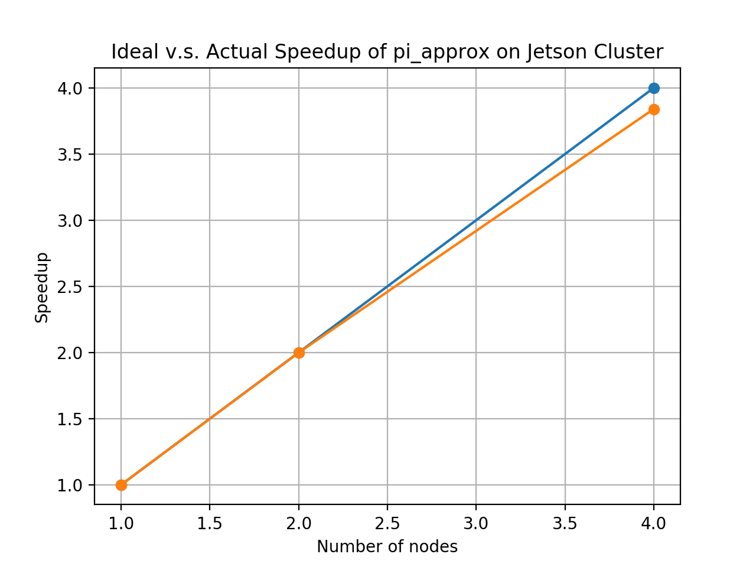
Speedup of pi_approx on Jetson TK1 Cluster

Slide 14
Further Inquiry
Compare data to official Lewis University supercomputer
TX2 Array Server
24x NVIDIA Jetson TX2
GPU: 1 TFLOP/s 256-core with NVIDIA Pascal Architecture
CPU: 4x 64-bit ARM A57 CPUs + 2 NVIDIA Denver CPUs
Memory: 8GB LPDDR4
Storage: 32 GB eMMC

Slide 15
Even Further Inquiry
Explore different programming models for high-performance computing
Python
Matlab
Functional languages

Slide 16
Appendix
Code, data, and documents
https://github.com/drVulter/Supercomputer2017

Slide 17
References
http://www.netlib.org/benchmark/hpl/
https://www.top500.org/
https://portal.tacc.utexas.edu/c/document_library/get_file?uuid=e05d457a-0fbf-424b-87ce-c96fc0077099&groupId=13601
http://www.instructables.com/id/How-to-Make-a-Raspberry-Pi-SuperComputer/
https://blogs.nvidia.com/blog/2012/09/10/what-is-cuda-2/
https://computing.llnl.gov/tutorials/mpi/

